Slide 1

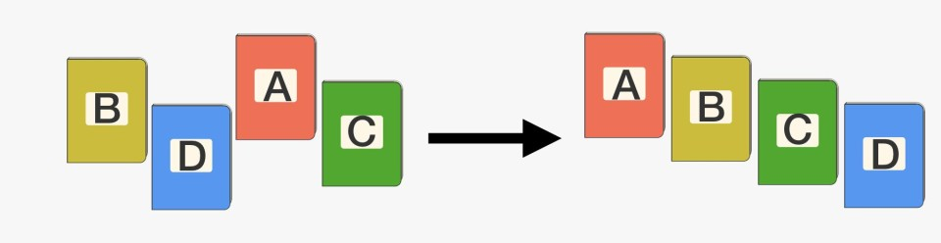
Chapter 5: Divide and Conquer
Quick Sort
DESIGN & ANALYSIS OF ALGORITHM (BCSC0012)

Slide 2
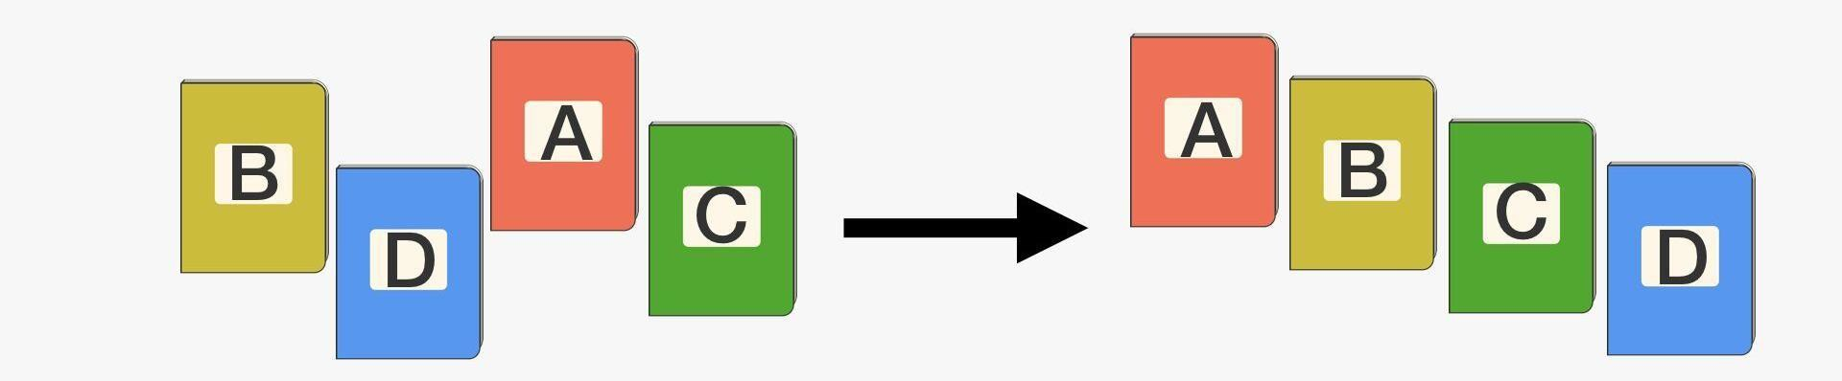
The Sorting Problem
Input:
A sequence of n numbers a₁, a₂, . . . , a_{n}
Output:
A permutation (reordering) a₁’, a₂’, . . . , a_{n}’ of the input sequence such that a₁’ ≤ a₂’ ≤ · · · ≤ a_{n}’

Slide 3
The Sorting Problem
Sorting takes an unordered collection and makes it an ordered one.
1 2 3 4 5 6
77 | 42 | 35 | 12 | 101 | 5
1
2
3
4
5
6
5 | 12 | 35 | 42 | 77 | 101

Slide 4
The Sorting Problem: Some Definitions
Internal Sort
The data to be sorted is all stored in the computer’s main memory.
External Sort
Some of the data to be sorted might be stored in some external, slower, device.
In Place Sort
The amount of extra space required to sort the data is constant with the input size.

Slide 5
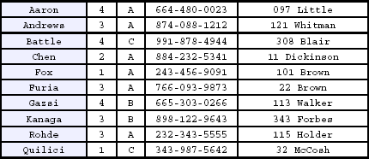
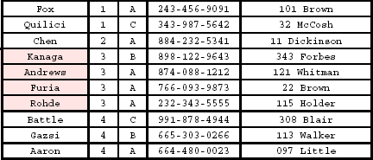
The Sorting Problem: Some Definitions
Stable sort
A STABLE sort preserves relative order of records with equal keys
Sorted on first key:
Sort file on second key:
Records with key value 3 are not in order on first key!!

Slide 6
Divide and Conquer
Sorting Algorithms
Bubble sort
Selection sort
Insertion Sort
Quick Sort
Merge Sort
Divide-ConquerApproach

Slide 7

Divide and Conquer: Quick Sort
Quicksort is an in-place sorting algorithm. Developed by British computer scientist Tony Hoare in 1959
January/February 2000 issue of Computing in Science & Engineering, a joint publication of the American Institute of Physics and the IEEE Computer Society, selected quicksort as one of the 10 algorithms “with the greatest influence on the development and practice of science and engineering in the 20th century.”
Tony Hoare
(Developer of Quick sort)

Slide 8
Divide and Conquer: Quick Sort
Follows the divide-and-conquer paradigm.
Divide: Partition (separate) the array A[p..r] into two subarrays A[p..q–
and A[q+1..r].
Each element in A[p..q–1] < A[q].
A[q] < each element in A[q+1..r].
Index q is computed as part of the partitioning procedure.
Conquer: Sort the two subarrays by recursive calls to quicksort.
Combine: The subarrays are sorted in place – no work is needed to combine them.
How do the divide and combine steps of quicksort compare with those of merge sort?

Slide 9
Divide and Conquer: Quick Sort …
Quicksort(A, p, r)
if p < r then
q := Partition(A, p, r); Quicksort(A, p, q – 1); Quicksort(A, q + 1, r)
Partition(A, p, r)
x:= A[r], i:=p – 1;
for j := p to r – 1 do if A[j] ≤ x then
{ i := i + 1; A[i] ↔ A[j];}
A[i + 1] ↔ A[r];
return i + 1
A[p..r]
 |  |  |  | 5
A[p..q – 1]
Partition
A[q+1..r]
 |  | 5
≤ 5
≥ 5

Slide 10
Divide and Conquer: Quick Sort …
initially: | p 2 | 5 | 8 | 3 | 9 | 4 | 1 | 7 | 10 | r 6
i | j
next iteration: | 2 i | 5 j | 8 | 3 | 9 | 4 | 1 | 7 | 10 | 6
next iteration: | 2 | 5 i | 8 j | 3 | 9 | 4 | 1 | 7 | 10 | 6
next iteration: | 2 | 5 i | 8 | 3 j | 9 | 4 | 1 | 7 | 10 | 6
next iteration: | 2 | 5 | 3 i | 8 | 9 j | 4 | 1 | 7 | 10 | 6
note: pivot (x) = 6
Partition(A, p, r)
x:= A[r], i:=p – 1;
for j := p to r – 1 do if A[j] ≤ x then
{ i := i + 1;
A[i] ↔ A[j];}
A[i + 1] ↔ A[r];
return i + 1

Slide 11
Divide and Conquer: Quick Sort …
next iteration: | 2 | 5 | 3 | 8 | 9 | 4 | 1 | 7 | 10 | 6
 |  |  | i |  | j
next iteration: | 2 | 5 | 3 | 8 | 9 | 4 | 1 | 7 | 10 | 6
 |  |  | i |  |  | j
next iteration: | 2 | 5 | 3 | 4 | 9 | 8 | 1 | 7 | 10 | 6
 |  |  |  | i |  |  | j
next iteration: | 2 | 5 | 3 | 4 | 1 | 8 | 9 | 7 | 10 | 6
 |  |  |  |  | i |  |  | j
next iteration: | 2 | 5 | 3 | 4 | 1 | 8 | 9 | 7 | 10 | 6
 |  |  |  |  | i |  |  |  | j
next iteration: | 2 | 5 | 3 | 4 | 1 | 8 | 9 | 7 | 10 | 6
 |  |  |  |  | i |  |  |  |  | j
after final swap: | 2 | 5 | 3 | 4 | 1 | 6 | 9 | 7 | 10 | 8
 |  |  |  |  | i |  |  |  |  | j
Partition(A, p, r)
x:= A[r], i:=p – 1;
for j := p to r – 1 do if A[j] ≤ x then
{ i := i + 1; A[i] ↔ A[j];}
A[i + 1] ↔ A[r];
return i + 1

Slide 12
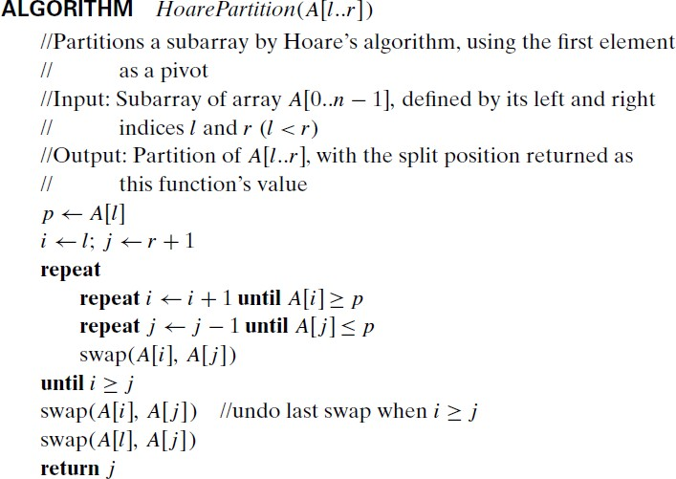
Divide and Conquer: Quick Sort …
CASE:
First element as a Pivot

Slide 13
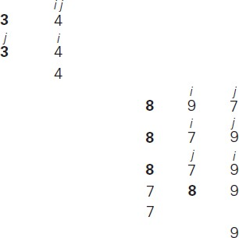
Divide and Conquer: Quick Sort …
Example

Slide 14
Divide and Conquer: Quick Sort …
Analysis of quicksort—best case
Algorithm always chooses best pivot and splits sub-arrays in half at each recursion
T(0) = T(1) = O(1)
constant time if 0 or 1 element
For N > 1, 2 recursive calls plus linear time for partitioning
T(N) = 2T(N/2) + O(N)
Same recurrence relation as Mergesort
T(N) = O(N log N)

Slide 15
Divide and Conquer: Quick Sort …
Analysis of quicksort - Worst Case
Algorithm always chooses the worst pivot – one sub-array is empty at each recursion
T(N) ≤ a for N ≤ C
T(N) ≤ T(N-1) + bN
≤ T(N-2) + b(N-1) + bN
≤ T(C) + b(C+1)+ … + bN
≤ a +b(C + (C+1) + (C+2) + … + N)
T(N) = O(N²)
Fortunately, average case performance is
O(N log N)

